Slide 1

Platform as a Service and Microsoft Azure Stack Hub
Azure Stack Hub PaaS Concepts and Capabilities
This work is licensed under a Creative Commons Attribution - ShareAlike 4.0 International Public License

Slide 2
Agenda
Ecosystem of Services
Delivered as a Template
Delivered as a PaaS
PaaS Overview
Introduction
Overview
PaaS in Public Azure and Azure Stack Hub
PaaS in Public Azure
PaaS in Azure Stack Hub
App Service
Web Apps, API Apps, and Functions
Service Fabric
Service Fabric

Slide 3
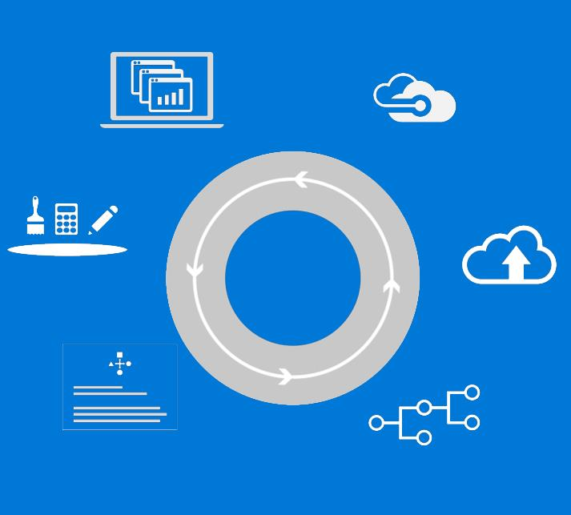
Unified application development and DevOps
Describe
Deploy
Control
Visual Studio | OSS tools
Experiences
Operations
Build and deploy apps the same way whether they run on-premises(traditional on-premises or hybrid cloud via Azure Stack Hub) or in the public cloud
Implement common DevOps practices across hybrid cloud environments.
Azure Resource Manager
Azure Resource Manager
Tools
Deployments
Consistency
Application Patterns
Automations
Azure Stack Hub
Azure

Slide 4
Azure and Azure Stack Hub Truly consistent hybrid cloud platform
Portal | PowerShell | DevOps tools
Developers
Portal | PowerShell | DevOps tools
Azure Resource Manager
Azure Resource Manager
CONSISTENCY
Azure IaaS | Azure PaaS
Azure IaaS | Azure PaaS
Compute | Networking | Storage |
App Service | Functions |
Service Fabric* | Container Service*
Cloud infrastructure
Cloud infrastructure
(Integrated systems)
IT
Azure
Azure Stack Hub
* - Post GA

Slide 5
PaaS – Platform as a Service

Slide 6



Cloud computing
IaaS
PaaS
SaaS
Infrastructure as a Service
Platform as a Service
Software as a Service
Host
Build
Consume
Notes:
[EDITOR] TWB_Trevor:
04 October 2013 What does “PDC08” refer to? Is it a reference to the Professional Developers Conference held in 2008?

Slide 7


Cloud computing contd.
Packaged Software
Infrastructure
(as a Service)
Platform
(as a Service)
Software
(as a Service)
You manage
Applications
Applications
Applications
Applications
Data
You manage
Data
Data
Data
Runtime
Runtime
Runtime
Runtime
Managed by vendor
You manage
Middleware
Middleware
Middleware
Managed by vendor
Middleware
O/S
O/S
O/S
O/S
Virtualization
Virtualization
Managed by vendor
Virtualization
Virtualization
Servers
Servers
Servers
Servers
Storage
Storage
Storage
Storage
Networking
Networking
Networking
Networking
Notes:
[EDITOR] Biju
04 October 2013 Kindly provide substantiation for the claim made against third-party software.

Slide 8





Azure Stack Hub architecture
Additional
Platform
Services
From Microsoft
Storage Blobs
Websites
(.NET, PHP, Python … )
Guest Workload Resources
(IaaS + PaaS)
Websites
(.NET, PHP, Python … )
Virtual Machines
(Linux or Windows)
Service Fabric Clusters
Virtual Networks
Service Fabric Clusters
End User Experiences
End User Experiences
Azure Portal | Developer Tools (MSFT & Open Source)
Unified App Model
Unified Application Model
Azure Resource Manager
Core Services
Core Services
Subscriptions | RBAC | Gallery | Metrics | Usage
Azure Stack Hub Software
Extensible Service Framework
Additional Platform Services
Foundational Services
Compute | Storage | Networking | Platform Services
Foundational Services
Cloud Infrastructure
Infrastructure Management
Compute
Storage
Networking
From 3rd parties
Physical Hardware

Slide 9
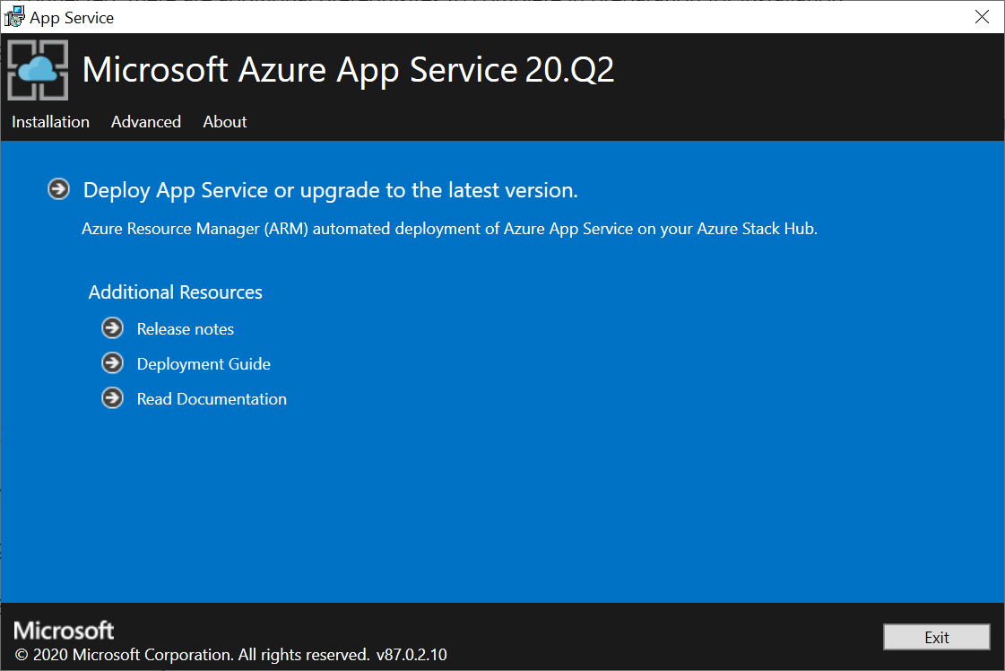
PaaS Resource Providers (RP)
None by Default
Add only as needed
~60GB+ free needed for each install
Win Server 2016 image required for all
Separate installation procedures / requirements
Can add more capacity to each later
Once installed, add to offers/plans
App Services RP
SQL & MySQL RPs
Event Hubs
Iot Hub

Slide 10
PaaS using templates in Azure Stack Hub
As an Azure Stack Hub Operator, you are given PaaS as part of Azure Stack Hub using Resource Providers, but you can also offer PaaS by deploying and managing IaaS templates to deliver PaaS solutions to your users…
Packaged Software
Infrastructure
(as a Service)
PaaS (Using Resource Provider)
Software
(as a Service)
You manage
Applications
Applications
Applications
Applications
Data
You manage
Data
Data
Data
Runtime
Runtime
Runtime
Runtime
Managed by vendor
You manage
Middleware
Middleware
Middleware
Managed by vendor
Middleware
O/S
O/S
O/S
O/S
Virtualization
Virtualization
Managed by vendor
Virtualization
Virtualization
Servers
Servers
Servers
Servers
Storage
Storage
Storage
Storage
Networking
Networking
Networking
Networking
PaaS (Using IaaS templated app)
Applications
You manage
Data
Runtime
Templated app
Middleware
O/S
Virtualization
Managed by vendor
Servers
Storage
Networking
Notes:
[EDITOR] Biju
04 October 2013 Kindly provide substantiation for the claim made against third-party software.

Slide 11
PaaS RP vs templates
With a Resource Provider:
The underlying resources are abstracted from the user and maintenance functions of those resources can be done by an administrator in the portal or using scripting/API calls:
Deployment
Updates
Monitoring
Certificate rotation
BCDR
Resource Providers are multi-tenant
Template-based deployments:
Must be managed like IaaS
Would have distinct management tools and procedures
Would be deployed to serve a specific user
Are less efficient in using resources when operating in a multi-tenant environment
PaaS (Using Resource Provider)
PaaS (Using IaaS templated app)
You manage
Applications
Applications
Data
You manage
Data
Runtime
Runtime
Templated app
Middleware
Managed by vendor
Middleware
O/S
O/S
Virtualization
Virtualization
Managed by vendor
Servers
Servers
Storage
Storage
Networking
Networking
Notes:
[EDITOR] Biju
04 October 2013 Kindly provide substantiation for the claim made against third-party software.

Slide 12
New Resource Providers
Enhancements to the Azure Stack Hub Marketplace allow you to obtain, install, maintain, and remove the newest Resource Providers.
Event Hubs and IoT Hub Resource Providers use this
Web Apps and My/SQL resource providers do not use this currently
PaaS (Using Resource Provider)
PaaS (Using IaaS templated app)
You manage
Applications
Applications
Data
You manage
Data
Runtime
Runtime
Templated app
Middleware
Managed by vendor
Middleware
O/S
O/S
Virtualization
Virtualization
Managed by vendor
Servers
Servers
Storage
Storage
Networking
Networking
Notes:
[EDITOR] Biju
04 October 2013 Kindly provide substantiation for the claim made against third-party software.

Slide 13

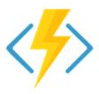

Azure PaaS App Services
Web Apps
Azure Functions
API Apps
Websites &
Web apps
Serverless computing
Hosting REST APIs

Slide 14
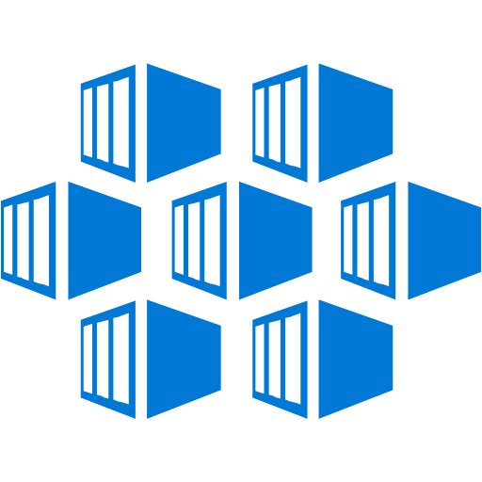
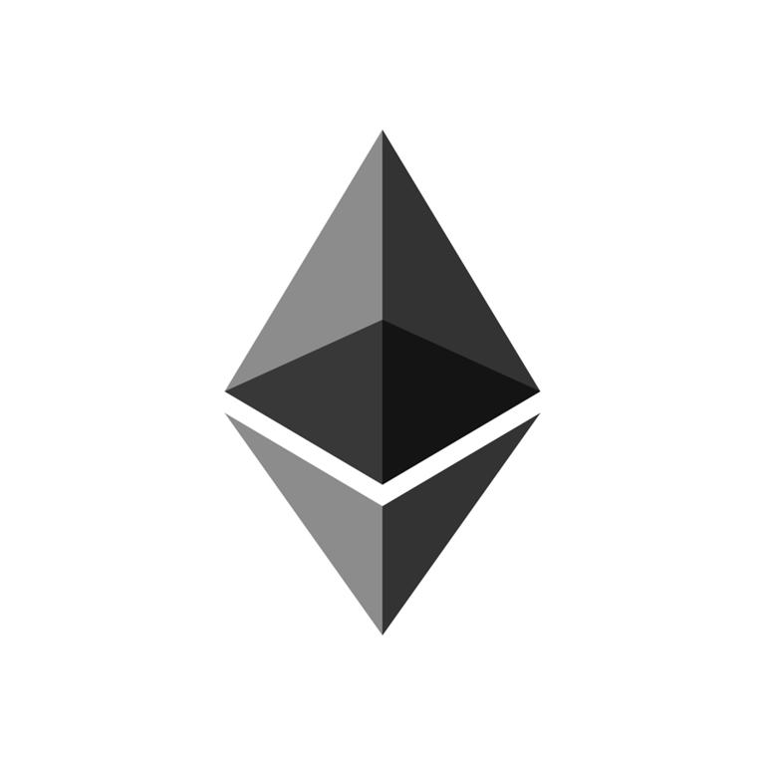
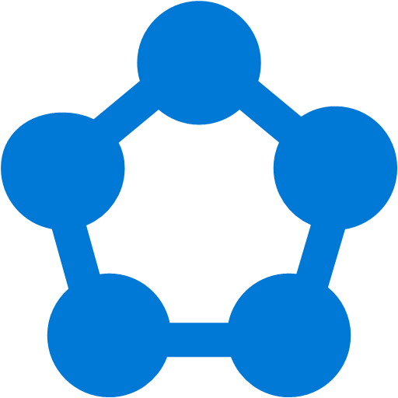
Azure PaaS available on-premises – managed platforms for high productivity development
Kubernetes
Cloud Foundry
Azure Ethereum Blockchain
Azure Service Fabric
Templated Version
Templated Version
Templated Version
Templated Version
Robust container management
Open source platform
Block chain services based on Ethereum
Always-on, scalable distributed applications

Slide 15
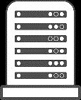
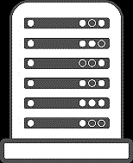

One Azure ecosystem
Mac OS X and Windows
Windows Server and Linux
Visual Studio
Eclipse
Azure Portal
GitHub
…
PowerShell
Docker
Chef and Puppet
…
Tools
Experiences
Automations
Azure Ecosystem
Microsoft Azure
Microsoft Azure Stack Hub

Slide 16
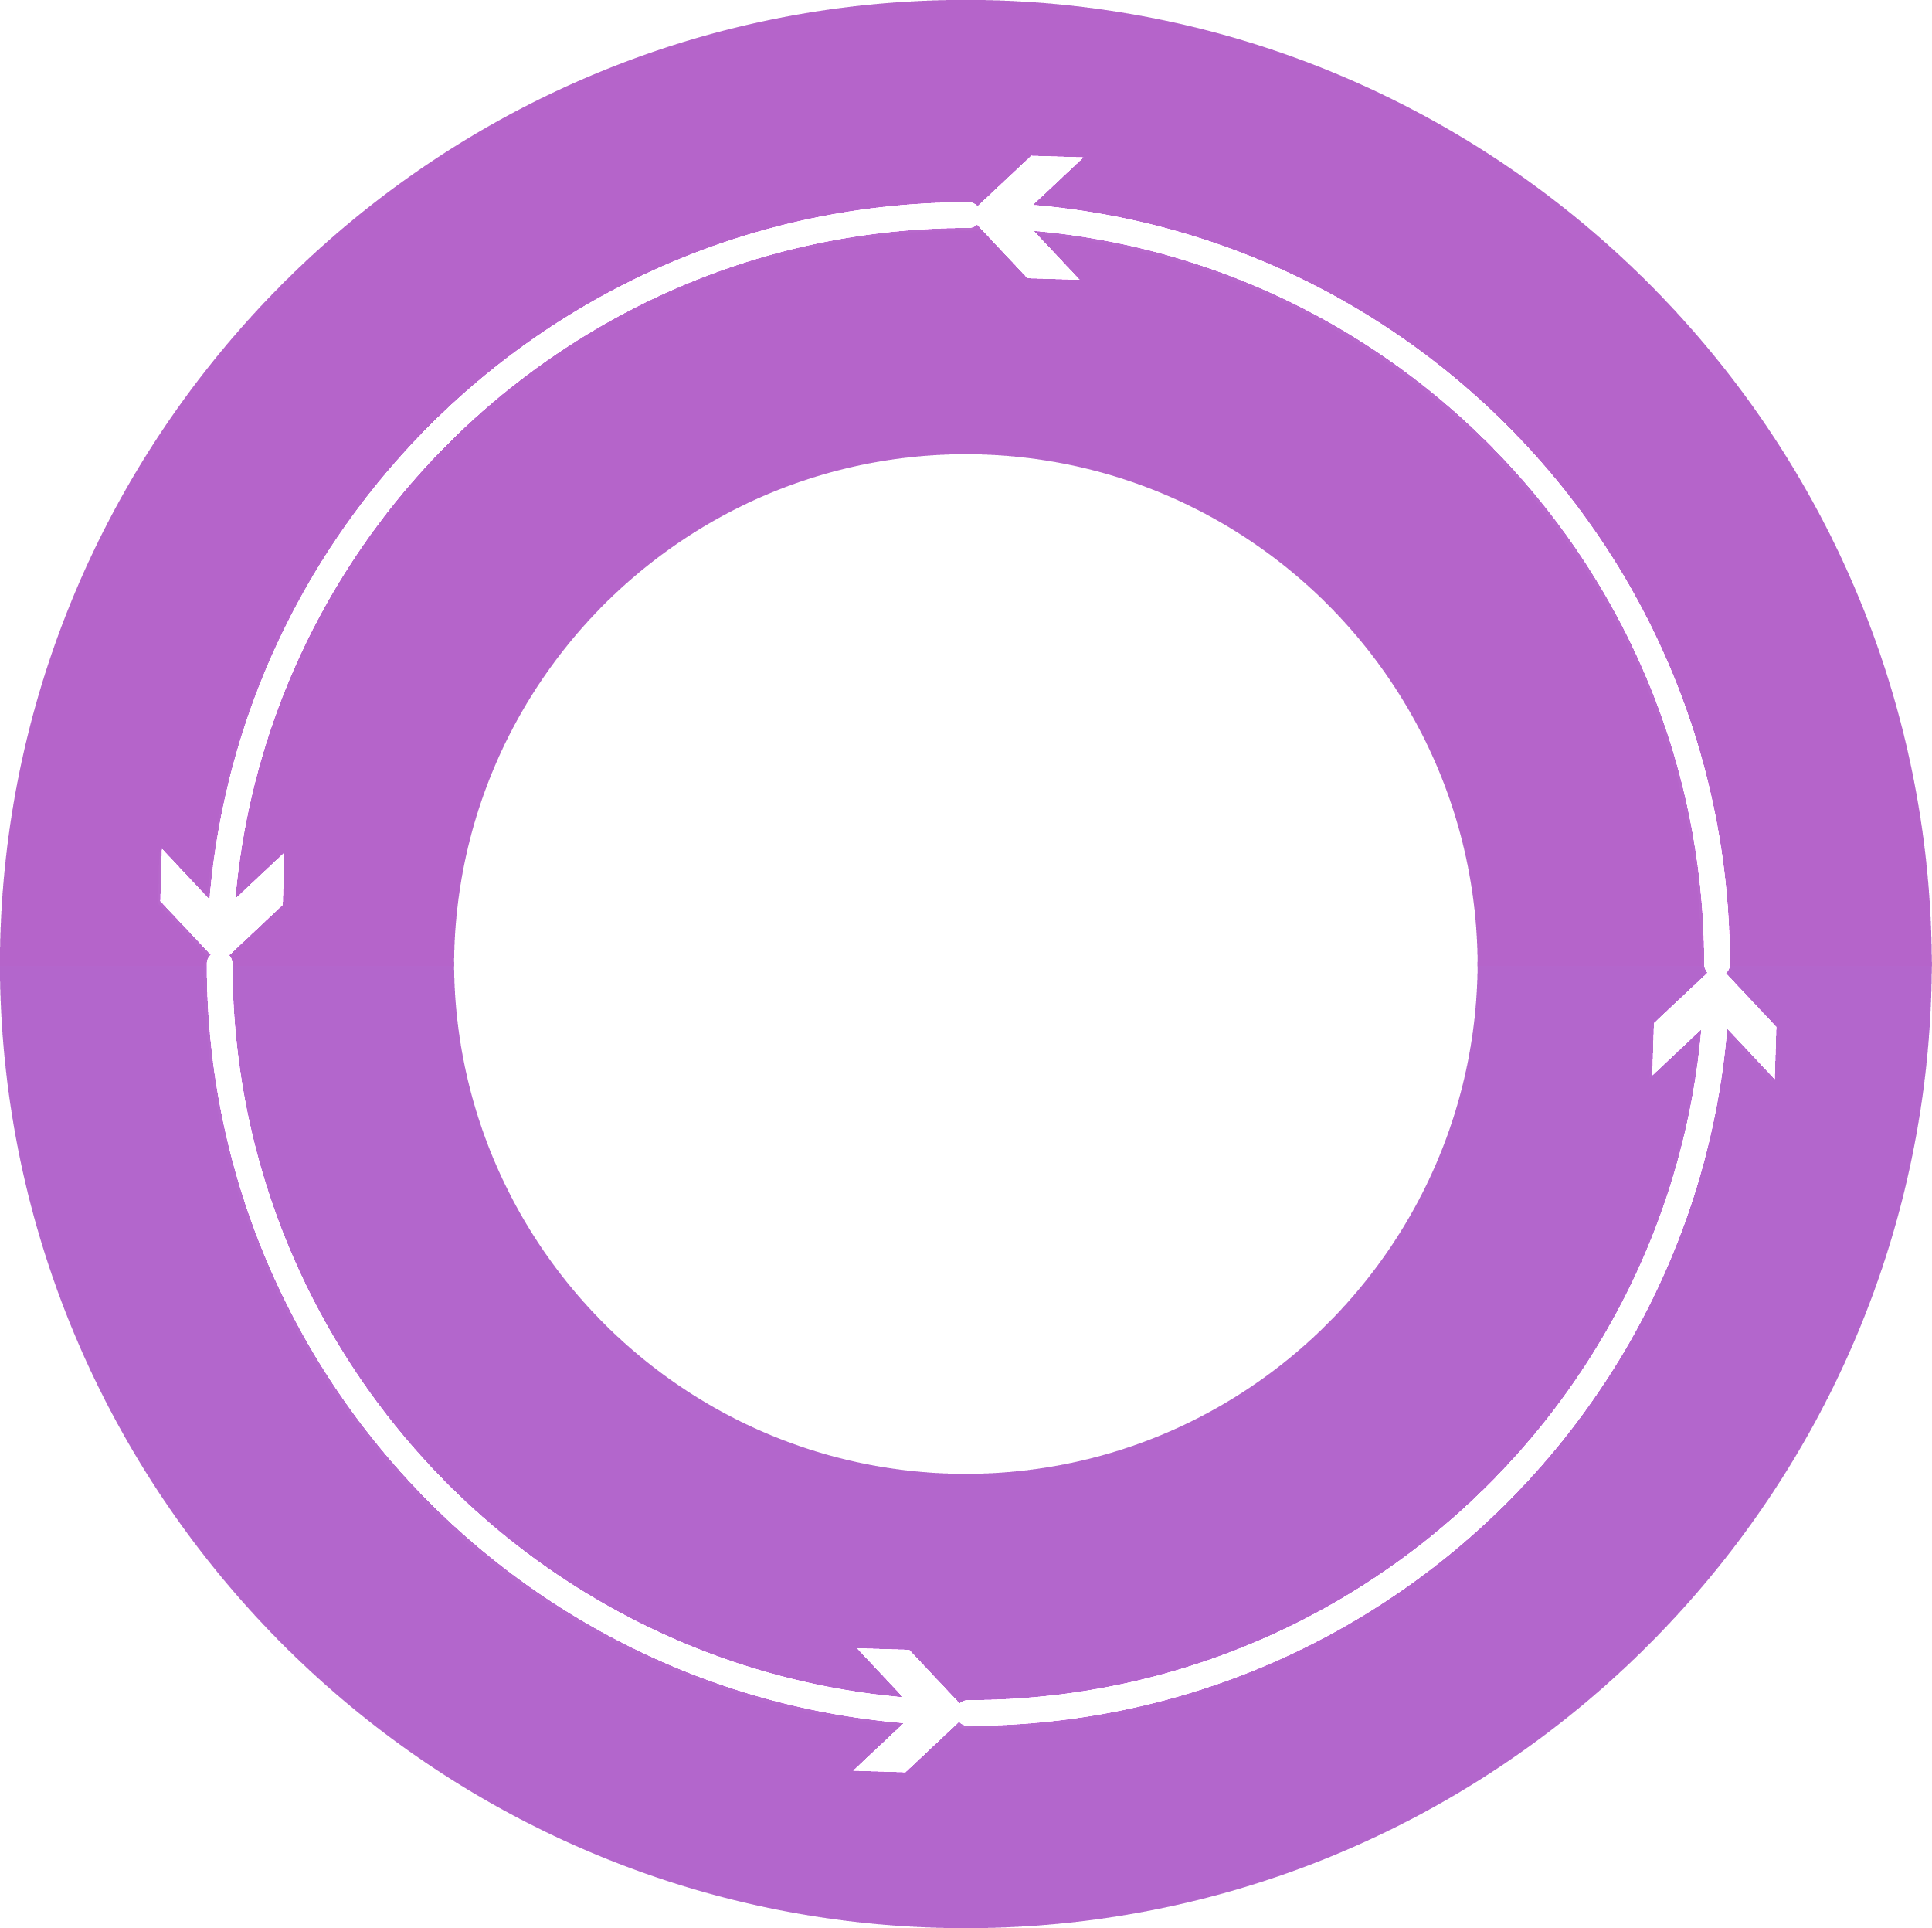
Additional Platform Services from Microsoft Azure
Develop Azure Services
Deliver services using
your datacenter
Repeat
Operate at
hyper-scale
Add provider experiences
Scale and integration points

Slide 17
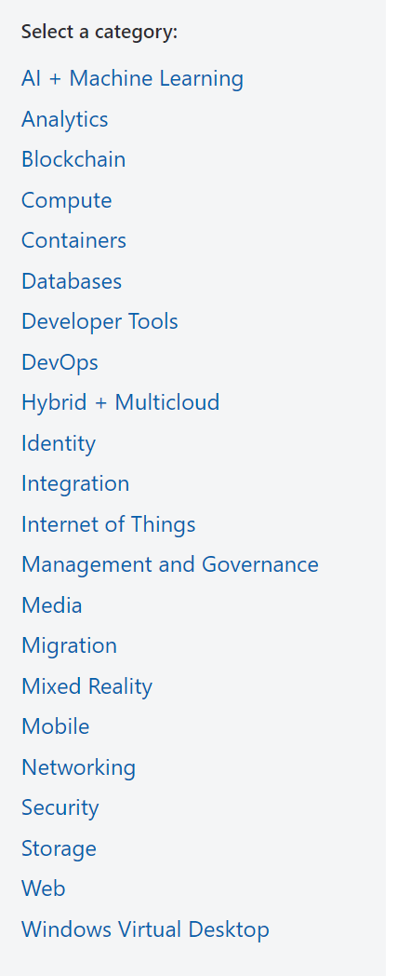
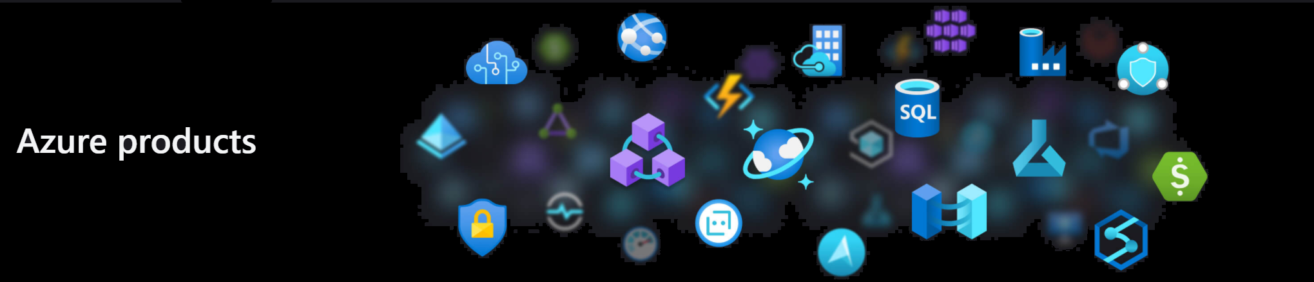









Platform Services from Microsoft Azure
Azure Services that can be also used in Azure Stack
Directory of Azure Cloud Services | Microsoft Azure

Slide 18
PaaS in Azure Stack Hub

Slide 19
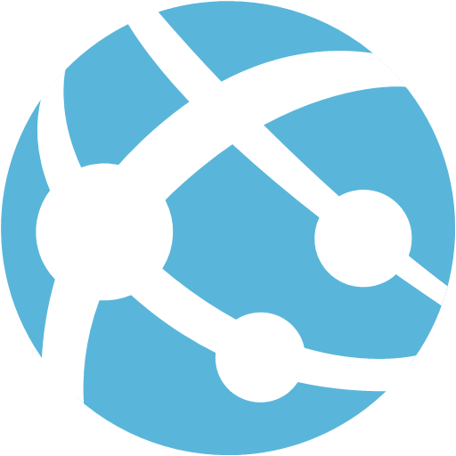
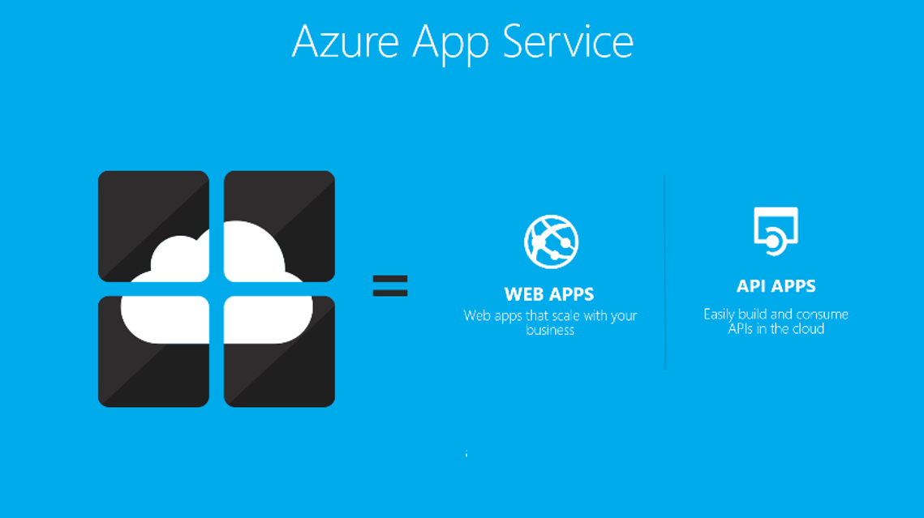
App Service | Web Apps
Allows developers rapidly build, deploy, and manage powerful websites and web apps using standards-based solutions and APIs
Web apps allow customers to:
Create personalized customer experiences
Scale up and out quickly
Centralize web sites on one platform
Enable continuous deployment with Git, TFS, GitHub, and Visual Studio Team Services
Build solutions based on Windows and Linux images
https://azure.microsoft.com/en-us/services/app-service/web

Slide 20

App Service | API Apps
Support the building, hosting, and consumption of APIs in the cloud and on-premises. API apps provide enterprise grade security, simple access control, hybrid connectivity, and automatic SDK generation. Key features include: Bring your existing API as-is – Code changes in existing APIs is not required to take advantage of API Apps Easy consumption – Integrated support for Swagger API metadata makes your APIs easily consumable by a variety of clients. Simple access control – Protects an API app from unauthenticated access with no changes to your code and provides built-in authentication services Visual Studio integration – Dedicated tools in Visual Studio streamline the work of creating, deploying, consuming, debugging, and managing API apps.
https://azure.microsoft.com/en-us/services/app-service/api

Slide 21

App Service | Functions
Azure Functions is a solution for easily running small pieces of code, or "functions," in the cloud.
Solution for processing data, integrating systems, working with the internet-of-things (IoT), and building simple APIs and microservices.
Key features of Azure Functions:
Choice of language – Write functions using C#, F#, Node.js, Python, PHP, batch, bash, or any executable.
Bring your own dependencies – Supports NuGet, and NPM
Integrated security – Protect HTTP-triggered functions with OAuth providers such as Azure Active Directory, Facebook, Google, Twitter, and Microsoft Account
Simplified integration – Easily leverage Azure services and software-as-a-service (SaaS) offerings
Flexible development – Supports continuous integration and deploy your code through GitHub, VSTS, and other supported development tools
Open-source – The Functions’ runtime is open-source and available on GitHub
https://azure.microsoft.com/en-us/services/functions

Slide 22
App Service | Prerequisites
Use the helper script!
Creates the following resources:
A Virtual Network
One Storage Account and subnet
One Public IP
One Virtual machine configured for App Service standalone file server
Prerequisites for ALL Resource Providers
Register Azure Stack Hub with Azure
Update your Azure Active Directory (Azure AD) home directory
Specifics to App Service
Download Scripts & Installer
Certificates
File Server – groups, accounts, share
SQL Instance
Azure Stack Root Certificate
Virtual Networks
Identity Application (Service Primcipal)
Windows Server 2016 Datacenter
Customer Script Extension
NOTE: Standalone file server is not HA and should only be used in dev and test scenarios.
https://docs.microsoft.com/en-us/azure-stack/operator/azure-stack-app-service-before-you-get-started

Slide 23
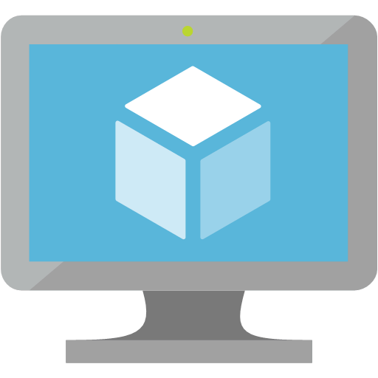
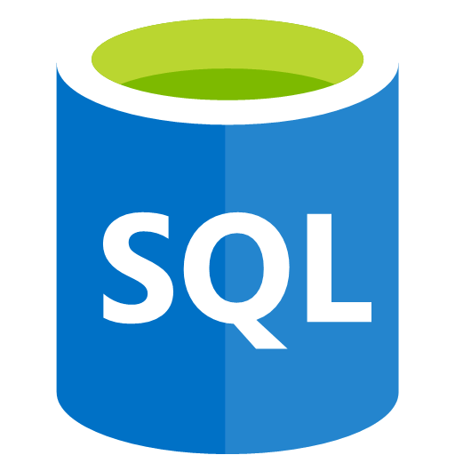
SQL Server
This feature, based on the codebase from Azure Pack, is ported to Azure Stack Hub.
The SQL Server Resource Provider can be used to manage SQL server resources (IaaS). You use this resource provider to connect to a SQL Server instance running in a VM.
The Resource Provider allows for management of SQL Server databases, and hosting servers.
SQL Server Resource Provider supported operations:
Create, delete, update, and retrieve databases
Create, validate, delete, update, and retrieve hosting servers
Retrieve resource provider metrics
Considerations
An administrator needs to manage the underlying IaaS Instance of SQL (patching, capacity planning, performance monitoring, etc.)
Any external SQL Server can be used, including SQL standalone servers, and VMs on Azure Stack Hub or Azure, as long as network connectivity can be achieved
No parity with SQL DB on Azure
Support for AlwaysOn Availability Groups

Slide 24
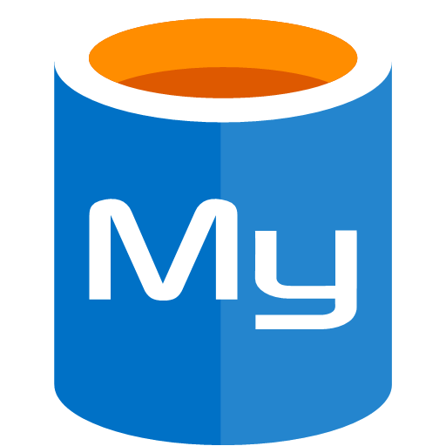
MySQL Server
This feature is based on the codebase from Azure Pack is ported to Azure Stack Hub.
The SQL Server Resource Provider can be used to manage MySQL resources (IaaS). This MySQL instance is also running in a VM – not as a PaaS service.
The Resource Provider allows for management of MySQL databases, and hosting servers.
MySQL Resource Provider supported operations:
Create, delete, update, and retrieve MySQL databases.
Create, validate, delete, update, and retrieve hosting servers.
Retrieve database metrics.
Considerations
An admin needs to manage the underlying IaaS Instance (same as SQL Server)
No parity with new Azure MySQL
Multiple MySQL versions are supported including Community Editions, clustered versions, and licensed software
https://docs.microsoft.com/en-us/azure-stack/operator/azure-stack-mysql-resource-provider

Slide 25
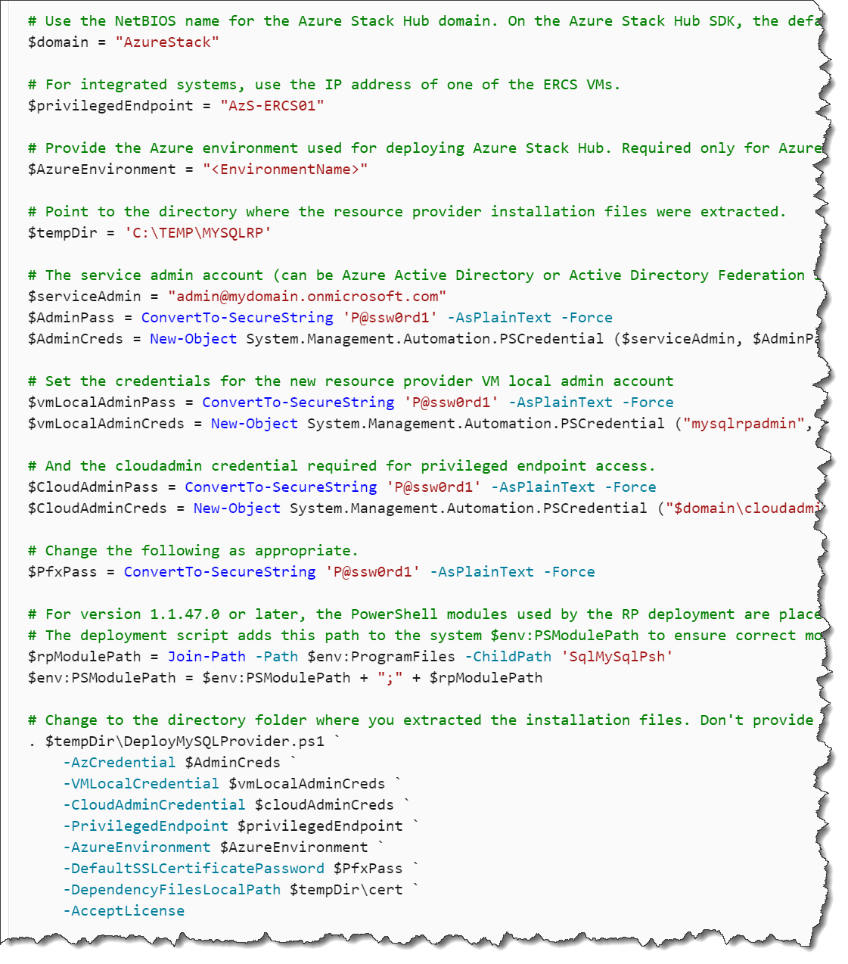
My/SQL Server RP Prerequisites
Things to have before beginning either of these:
Computer and Account to access Azure Stack Administrative Portal
Access to the Privileged Endpoint and ARM Admin Endpoints
Registration completed to access needed Marketplace items for Windows Server VMs
Download MySQL and SQL binaries from their prerequisites’ pages
Gather parameters for scripts
Datacenter integration
Conditional forwarding set
Inbound ports open
PKI certificate subject and SAN are set + pre-requisites for optional certificates
MySQL resource provider on Azure Stack Hub - Prerequisites
SQL Server resource provider - Prerequisites

Slide 26

Event Hubs on Azure Stack Hub
Streaming and event-based solutions are supported
For both on-premises and Azure cloud processing
Business Scenarios
AI and machine learning workloads where Event Hubs is the event streaming engine.
Implement event-driven architectures in your own sites outside the Azure data centers.
Clickstream analytics for your web application(s) deployed on-premises.
Device telemetry analysis.
Stream processing with open-source frameworks that use Apache Kafka such as Apache Spark, Flink, Storm, and Samza.
Service category | Compute
Availability | Now Available
AzureStack considerations:
Has “Common” Pre-requisites
Register new application in tenant
PKI SSL Pre-requisites
Deploy within Marketplace
Once in marketplace 2 hour install
https://docs.microsoft.com/en-us/azure-stack/operator/event-hubs-rp-overview

Slide 27
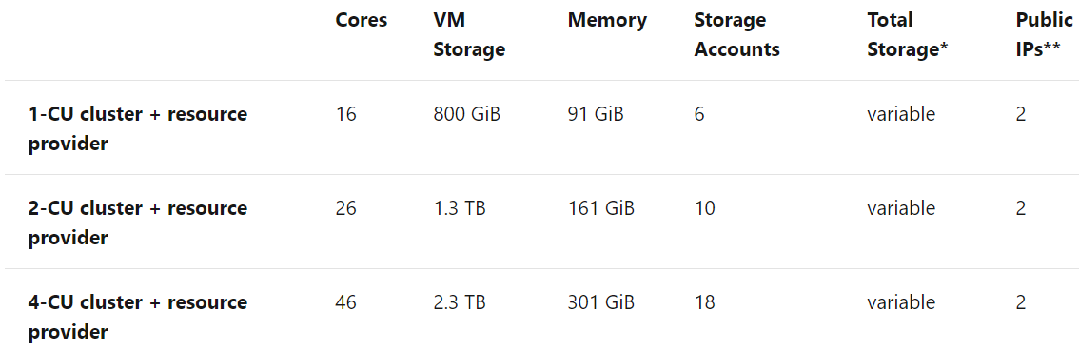
Event Hubs | Capacity Planning
Event Hubs
Users create Event Hubs clusters based on Capacity Units (CUs)
Don't specify a CPU core count
But, every CU directly maps to a specific number of cores consumed
All Event Hubs clusters use a D11_V2 VM type for their nodes
Total capacity consumed includes resource consumption by the RP and by user-created clusters
Plan capacity for Event Hubs

Slide 28

IoT Hub on Azure Stack Hub
Build IoT solutions with reliable and secure communications between IoT devices and a on-prem solution backend
Create hybrid IoT solutions.
IoT Hub is a managed service
Acts as a central message hub for bi-directional communication between your IoT application and the devices it manages.
Service category | Compute
Availability | In Preview – free for now
AzureStack considerations:
Dependent upon Event Hubs!
Deploy within Marketplace
Has “Common” Pre-requisites
PKI SSL Pre-requisites
Set Conditional DNS Forwarding

Slide 29
Event Hubs & IoT Hub | Prerequisites
Common
Register stack if not done already
Disconnected Marketplace considerations
Update Azure AD home directory
Common (once only)
Register stack if not done already
Disconnected Marketplace considerations
Update Azure AD home directory
Certificates
SAN - CN=*.eventhub.<region>.<fqdn>
Must be .pfx
Validate Certificate
Download packages
Certificates
SAN - CN=CN=*.mgmtiothub.<region>.<fqdn>
Must be .pfx
Validate Certificate
Pre-Download dependent packages 1st
Custom Script Extension
PowerShell Desired State Configuration
Free License: SQL Server 2016 SP2 Express on Windows Server 2016
SQL IaaS Extension
Azure Stack Add-On RP Windows Server
Prerequisites for Event Hubs
Prerequisites for installing IoT Hub

Slide 30

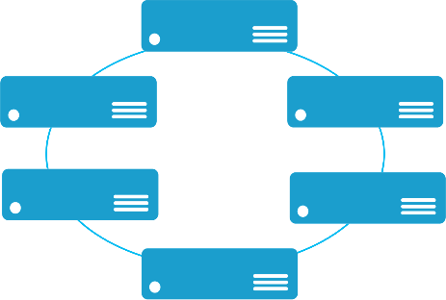
Service Fabric
Templated Version
Enables building and managing scalable and reliable applications composed of microservices that run at very high density on a shared pool of machines (cluster).
Provides a sophisticated runtime to build distributed, scalable, stateless and stateful microservices.
Provides comprehensive application management capabilities to provision, deploy, monitor, upgrade/patch, and delete deployed applications.
A microservice application separates functionality into separate smaller services.
Scales out by deploying each service independently creating instances of these services across servers /VMs/containers.
Service category | Compute
API version | Final Version
Availability | Marketplace template available now
AzureStack considerations:
This version of Service Fabric uses a clustered set of VMs built out from a Marketplace template that uses IaaS with PowerShell DSC for configuring the cluster. It is not a Resource Provider like App Service or SQL/mySQL
https://azure.microsoft.com/en-us/services/service-fabric

Slide 31
Kubernetes service
Templated Version
Develop massively scalable, upgradable, applications that can be deployed in seconds
Simplify the design of your application and improve its reliability by different Helm applications. Helm is an open-source packaging tool that helps you install and manage the lifecycle of Kubernetes applications
Easily monitor and diagnose the health of your applications with scale and upgrade functionality
Other Kubernetes tools, like the Kuberbetes-as-a-Service Rancher can also run on Azure Stack Hub
The actual application running on top of an AKS cluster is agnostic to whether it is running in public Azure or Azure Stack Hub – meaning high application portability between the clouds
.
Service category | Compute
API version | NA
Availability | Marketplace template available now
AzureStack considerations:
You can install Kubernetes using Azure Resource Manager templates generated by the ACS-Engine on Azure Stack Hub
The generated template is not the same managed AKS service offered in global Azure.
The generated ARM template deploys and provisions resources for Kubernetes in a single, coordinated operation
https://docs.microsoft.com/en-us/azure/aks/
https://docs.microsoft.com/en-us/azure/azure-stack/user/azure-stack-solution-template-kubernetes-deploy

Slide 32
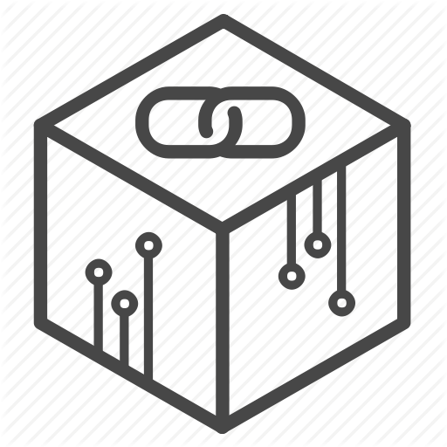
Blockchain Etherium service
Templated Version
Deploy a blockchain solution with Etherium
single-click deployment through the Azure Stack Hub tenant portal
Each member can provision their network footprint, consisting of a set of load-balanced transaction nodes with which an application or user can interact to submit transactions, a set of mining nodes to record transactions, and a Network Virtual Appliance (NVA)
A subsequent connection step connects the NVAs to create a fully configured multi-member blockchain network
Service category | Compute
API version | NA
Availability | Marketplace template available now
AzureStack considerations:
You can install Blockchain Etherium using Azure Resource Manager templates available in the marketplace
The templated deployment is not the same as the Azure Blockchain service
https://docs.microsoft.com/en-us/azure/azure-stack/user/azure-stack-ethereum

Slide 33
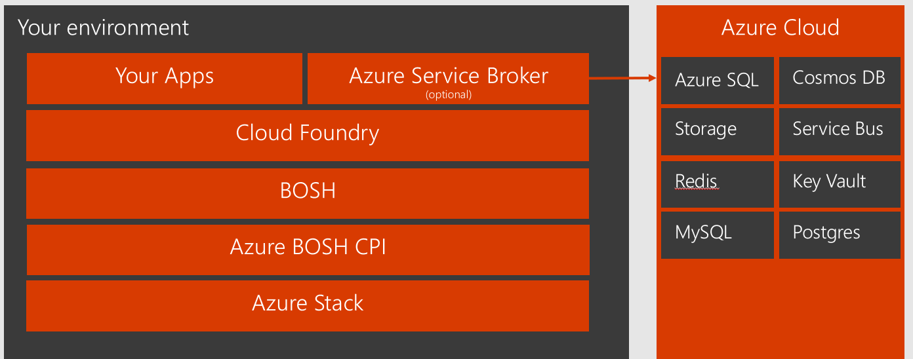
Cloud Foundry
Templated Version
an open source platform as a service by Pivotal
It is an open source platform that you can deploy to run your apps on your own computing infrastructure, or deploy on an IaaS like AWS, vSphere, or OpenStack.
Using Pivotal Cloud Foundry across Azure and Azure Stack on YouTube

Slide 34
Development, deployment, and management consistency across clouds
Consistent set of ARM Templates accommodating API version supports
Template validators for Azure Stack Hub
Consistent tool experience for PaaS Services
Visual Studio
Portal
CLI
Kudu (for web apps)

Slide 35
What if a desired Azure service is not available in Azure Stack Hub?
Deploy a hybrid solution, combining Azure Stack Hub services with Azure services
Where this is not possible, there are some services that can be run in IaaS on Azure Stack Hub as substitute for Azure services
For example Apache Cassandra/DataStax to run a NoSQL database instead of Azure CosmosDB

Slide 36
Developer Consistency
Visual Studio – Cloud Explorer – Consistent experience
Connect to Public Cloud
Connect to MAS
VS – Deploy – Same flow when deploying either to Public or MAS
Deploy to Azure
Deploy to MAS
Source Control Providers – Similar options
Local Git
GitHub
BitBucket
OneDrive
DropBox

Slide 37
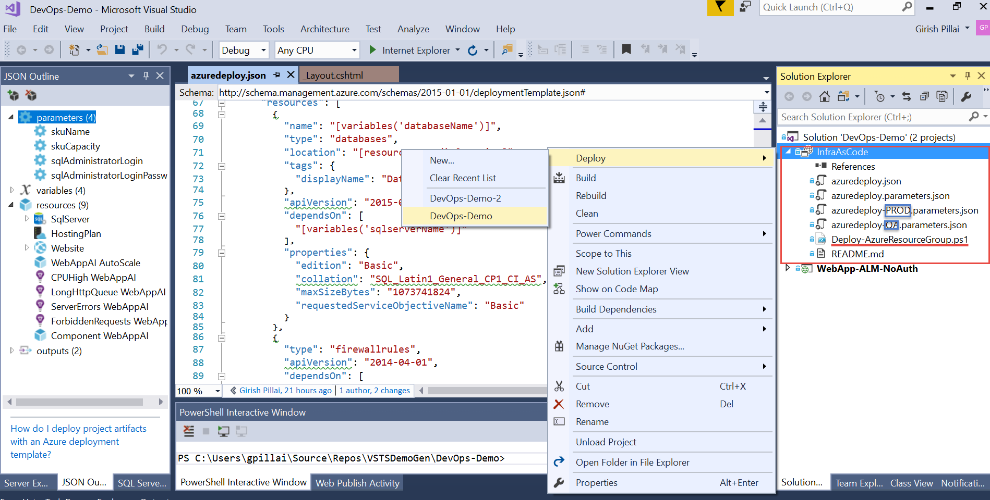

Slide 38
Questions?

